Slide 1



Localization and tracking of moving targets by microphones.
Master Intelligence Artificielle et Robotique (MIAR)
Prof. Ouiddad Labbani Igbida & Mons. Khadimoullah Ramoth
HEMANT RAMPHUL I21913
Notes:
Presentation Cover

Slide 2
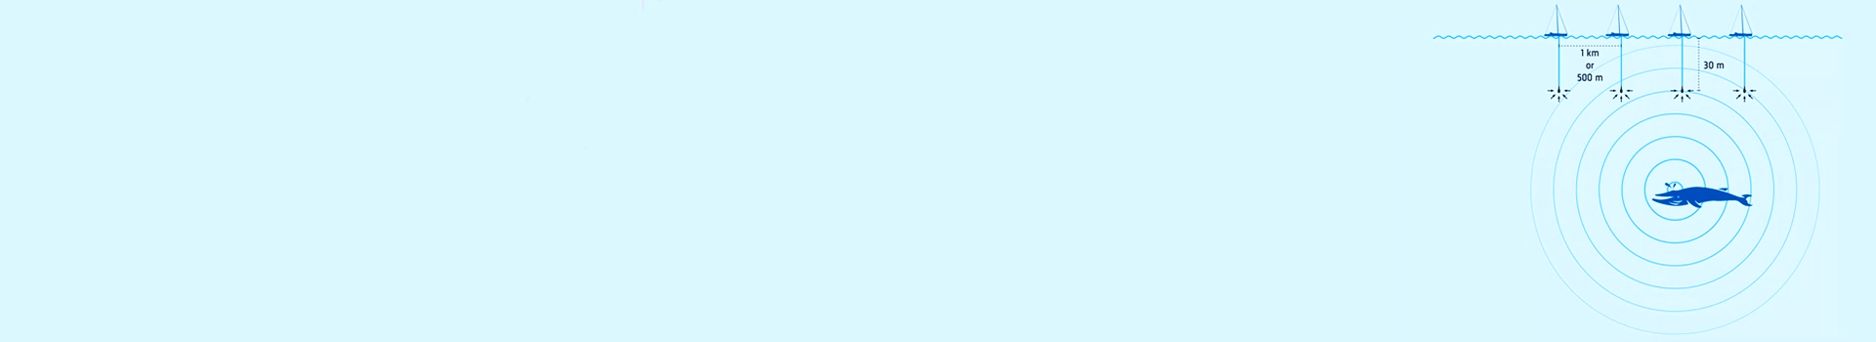
Agenda
Introduction
Methodology
Objectives and work accomplished
Use different technique of approach to obtain a satisfied result
Improve/change algorithms
Upgrade hardware
Establish performance metrics
Test system robustness with different technique and environment
Remark on final work and possible solution approach
Conclusion
Notes:
Agenda talk

Slide 3
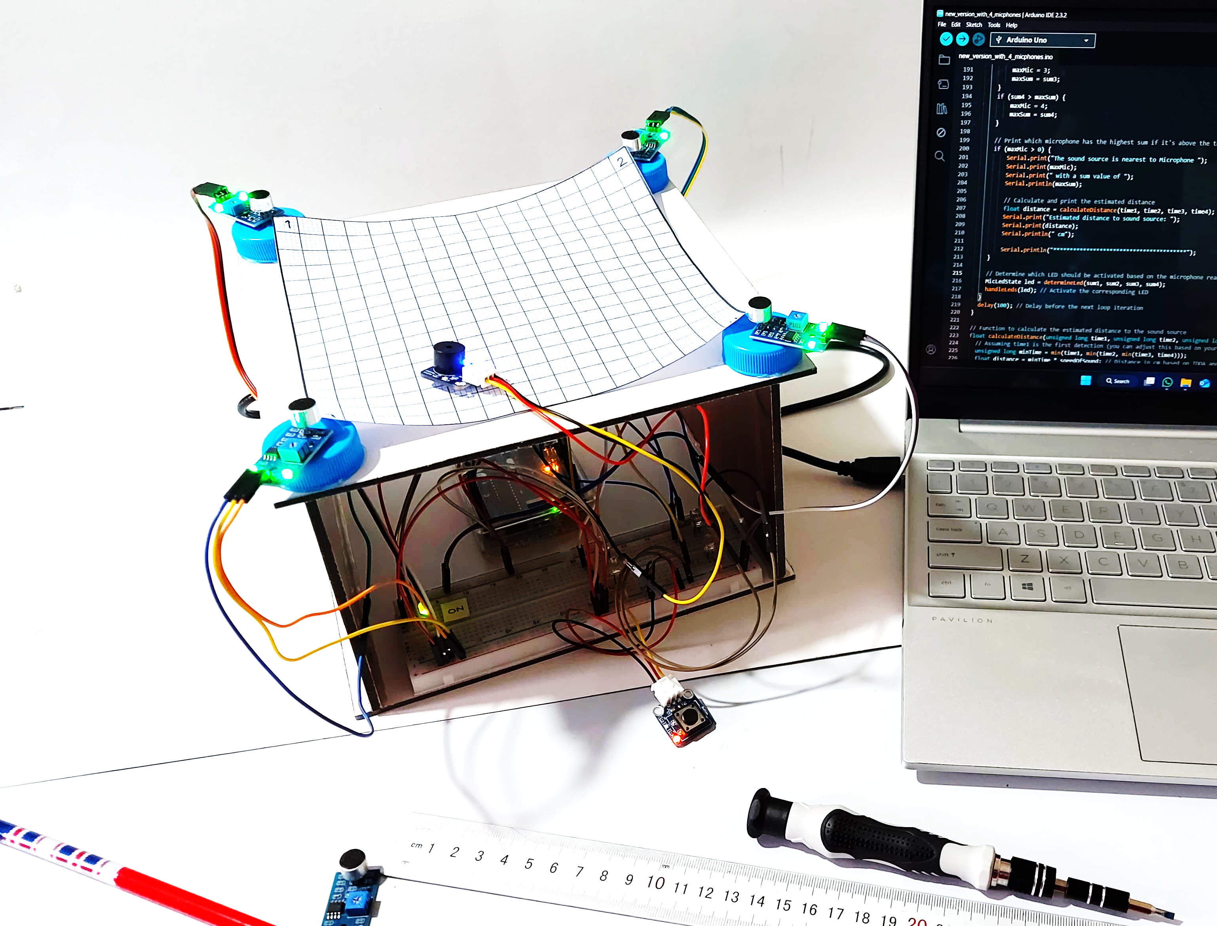
Introduction
Project goal
Develop an efficient sound localization system using the most appropriate methods and techniques to achieve the expected results.
Implement a four-microphone array positioned at the corners of a 17cm x 17cm square.
Algorithm used for localization
Uses Time Difference of Arrival (TDOA) method.
Measures differences in sound arrival times at each microphone.
Provides real-time feedback through LEDs indicating the direction.
Estimates distance to the sound source.
Localization and tracking of moving targets by hydrophones
Notes:
In this section, I will provide an overview of the project, highlighting the importance of sound localization and its applications in various fields.
The primary goal of this project was to develop a cost-effective and efficient sound localization system, then I choose to use a four-microphone array to do that.
By utilizing the Time Difference of Arrival (TDOA) method, I aimed to accurately determine the direction and distance of a sound source.
This presentation will walk through the methodology, objectives, and outcomes of our work, showing how I approached the challenge and the results I achieved.

Slide 4
Methodology
System Design
Four microphones arranged in a square configuration to capture sound from multiple directions.
Algorithm Development
Utilized the Time Difference of Arrival (TDOA) method to measure time differences in sound arrivals.
Signal Processing
Applied averaging to reduce noise and thresholding to focus on significant sound events.
Outcome
Combined techniques resulted in an accurate and robust sound localization system.
Localization and tracking of moving targets by hydrophones
Notes:
Methodology involved a comprehensive approach to system design, algorithm development, and signal processing.
The system was designed using a square configuration of four microphones to capture sound waves from different directions.
I implemented the TDOA method to measure the time differences in sound wave arrivals at each microphone.
To ensure accurate data collection, I used signal processing techniques such as averaging and thresholding to filter out noise and focus on significant sound events.
The combination of these methods allowed me to develop a robust sound localization system.

Slide 5
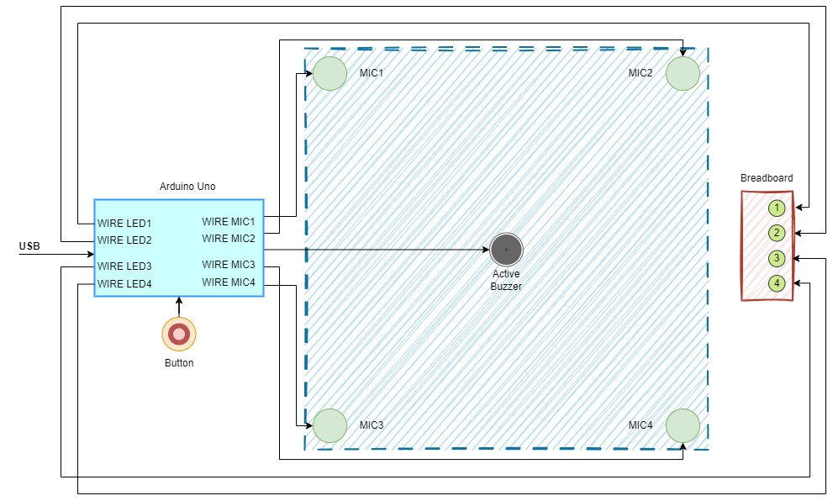
Objectives and work accomplished (1)
Design and Implementation Developed a four-microphone hardware setup.
Localization Implemented the Time Difference of Arrival (TDOA) method.
Algorithm Development Created algorithms to estimate sound source distance.
Testing and Evaluation Conducted tests to assess system performance and identified potential areas for improvement.
Notes:
In this project, our objectives were to design, implement, and test a sound localization system capable of accurately tracking sound sources.
The primary objectives included the development of a hardware setup with four microphones, implementing the TDOA method for localization, and developing algorithms to estimate the distance of sound sources.
Through rigorous testing, I aimed to evaluate the system's performance and identify areas for improvement.

Slide 6
Objectives and work accomplished (2)
Explored multiple techniques to improve localization accuracy.
Tested different microphone placements (linear and square configurations).
Adjusted threshold values for better sound detection.
Experimented with various signal processing methods to reduce noise interference.
Identified the most effective techniques for accurate localization under different conditions.
Localization and tracking of moving targets by hydrophones
Notes:
Throughout the project, I explored various techniques to enhance sound localization accuracy.
These included experimenting with different microphone placements, adjusting threshold values for sound detection, and testing various signal processing methods to reduce noise interference.
By comparing these approaches, I identified the most effective techniques for achieving accurate and reliable localization under different conditions, such as using a linear two-microphone setup and a square four-microphone configuration.

Slide 7
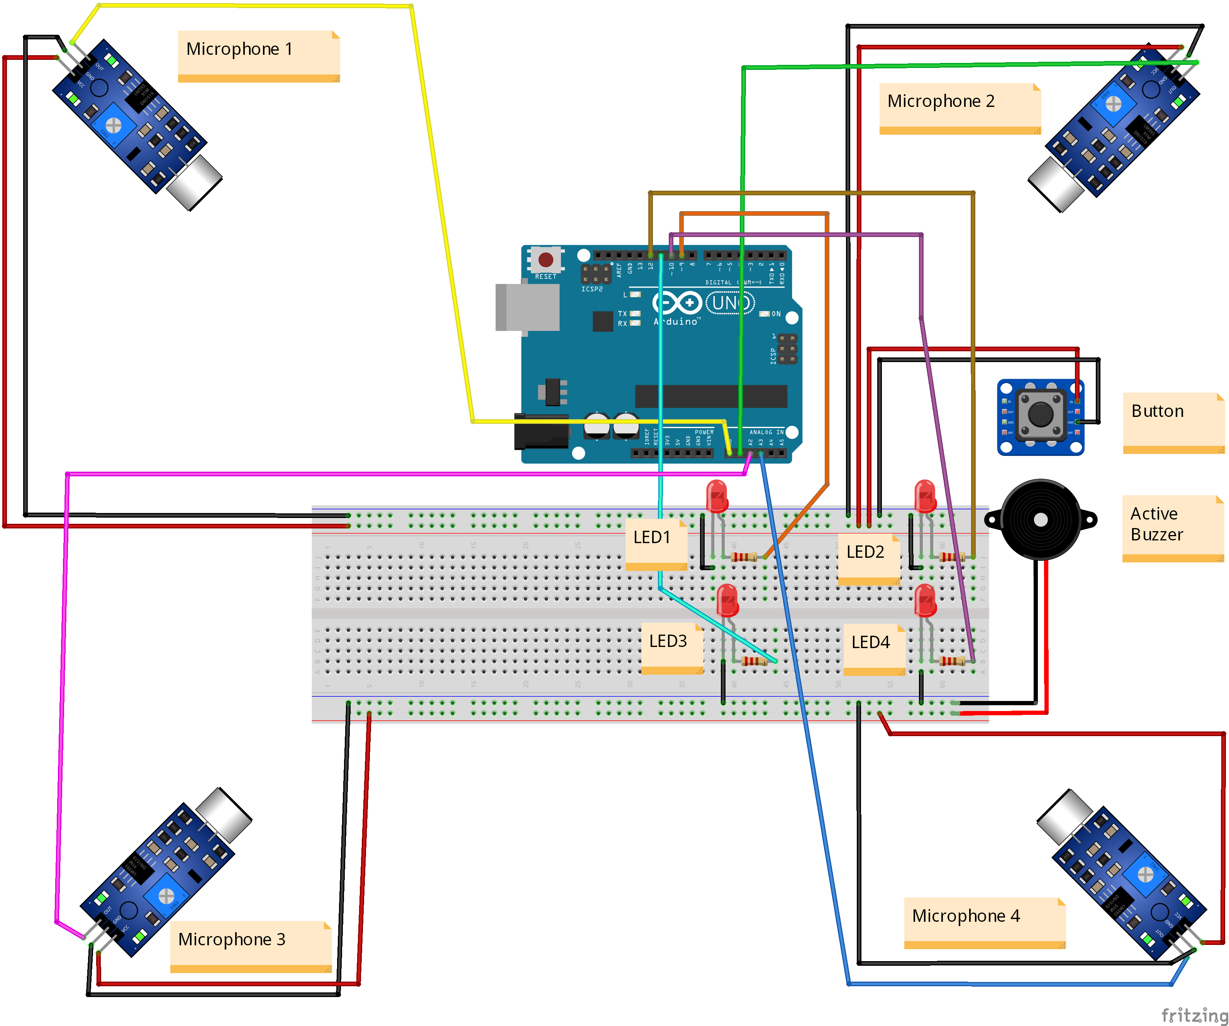
Upgrade hardware
Considered hardware upgrades to boost system performance.
Explored higher sensitivity microphones and improved signal processing components.
Investigated more powerful microcontrollers for complex calculations.
Aimed to enhance accuracy and speed in sound detection and localization for real-world use.
Localization and tracking of moving targets by hydrophones
Notes:
Hardware upgrades were considered to enhance the system's performance.
I explored the use of higher sensitivity microphones, better quality signal processing components, and more powerful microcontrollers to handle complex calculations.
These upgrades aimed to improve the accuracy and speed of sound detection and localization, making the system more efficient and effective for real-world applications.

Slide 8
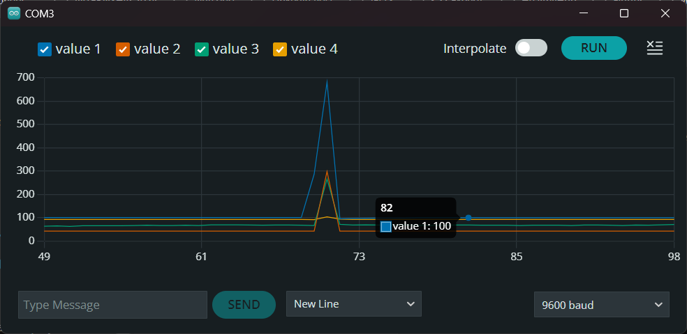
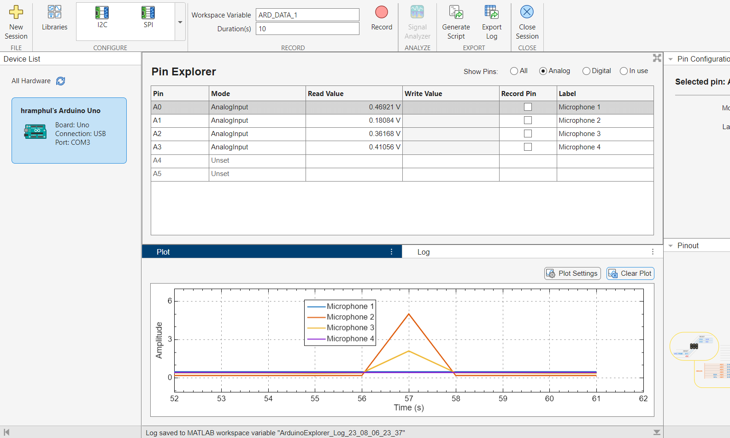
Establish performance metrics
Established metrics to evaluate system performance.
Measured accuracy in determining sound direction and precision in distance estimation.
These metrics guided the evaluation of system capabilities and highlighted areas for improvement.
Localization and tracking of moving targets by hydrophones
Notes:
To evaluate the effectiveness of the sound localization system, I established a set of performance metrics.
These included accuracy in determining sound direction, precision in distance estimation, response time to sound events, and robustness in different acoustic environments.
By using these metrics, I was able to systematically assess the system's capabilities and identify areas for further enhancement. Test System Robustness with Different Techniques and Environments

Slide 9
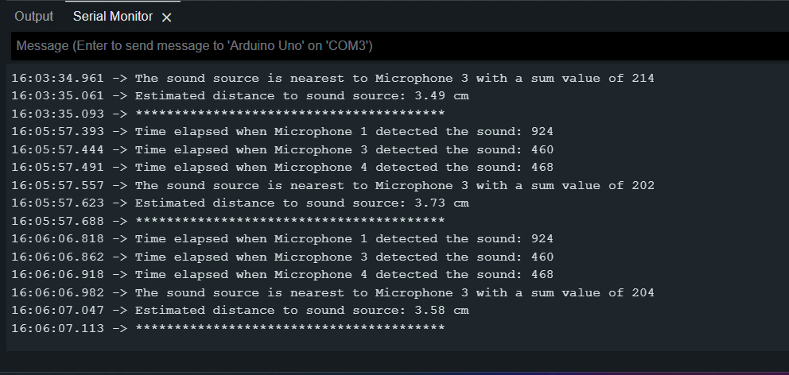
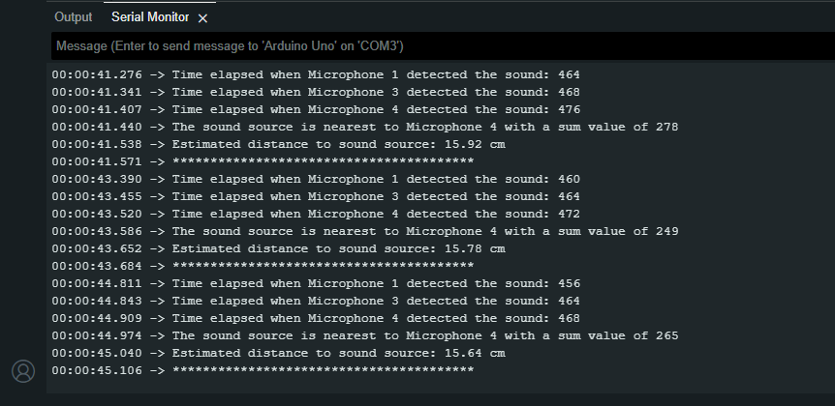
Test system with different techniques and environments
Conducted tests in quiet room.
Conducted tests in noisy settings, and open space.
Localization and tracking of moving targets by hydrophones
Notes:
Testing the system's robustness was essential to ensure its reliability across various scenarios.
I conducted experiments in different environments, including quiet rooms, noisy settings, and open spaces.
Different sound sources were used to test the system's response to various frequencies and intensities.
These tests helped me to understand the limitations of the system and the effectiveness of our approach under diverse conditions.

Slide 10
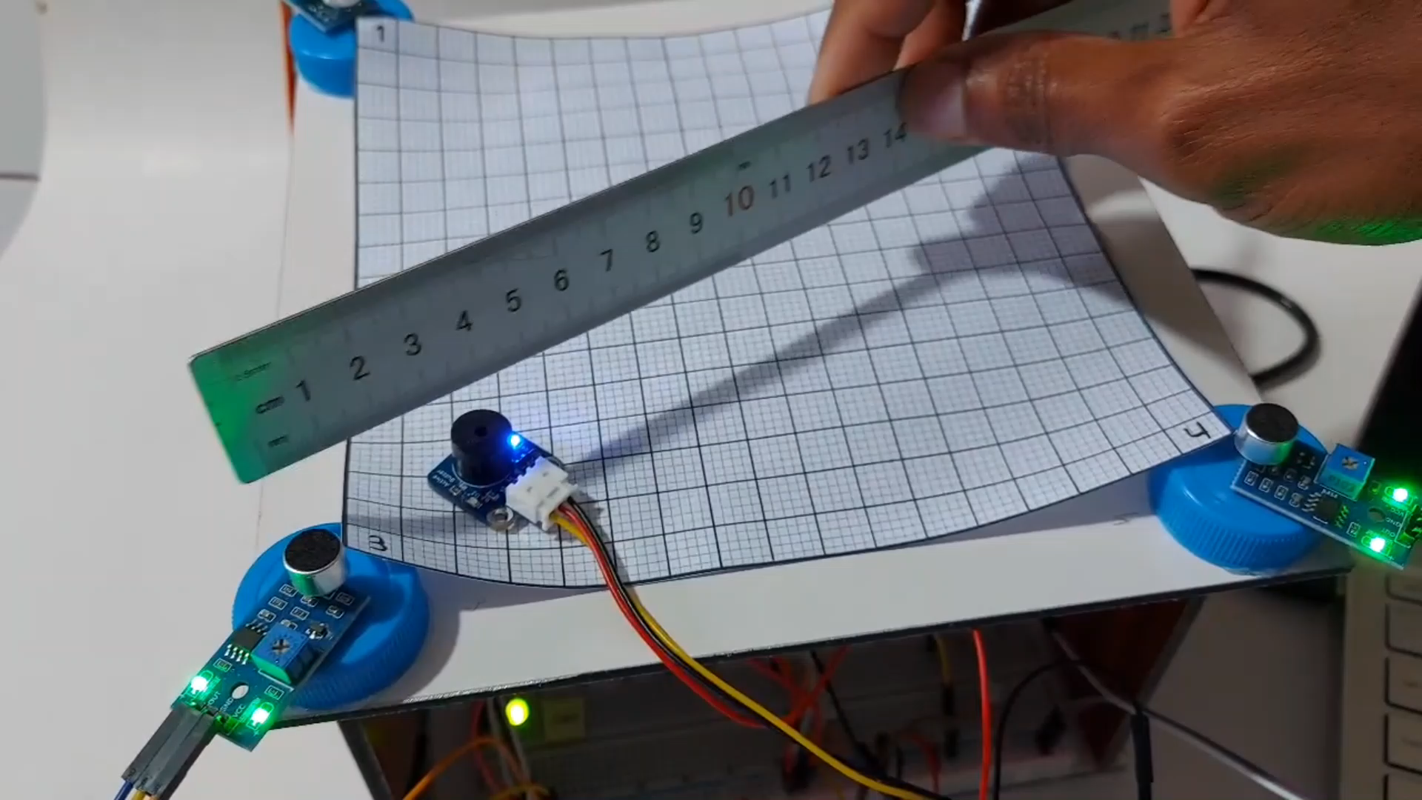

Slide 11
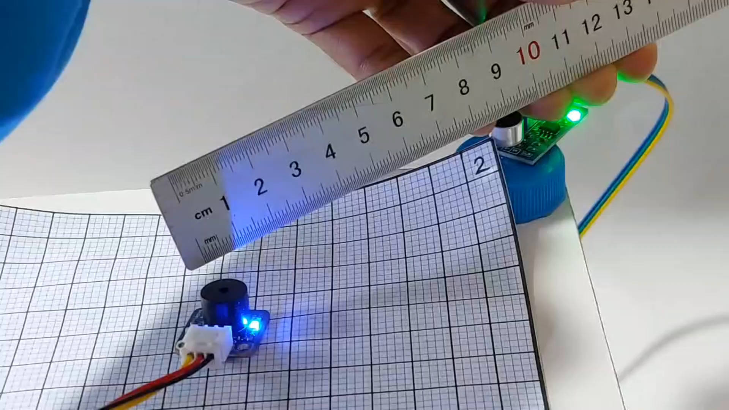

Slide 12
Remark on final solution and possible approach
Final Solution
Demonstrated the feasibility of using a four-microphone array and TDOA method.
Limitations identified in noisy environments and unexpected results.
Future work includes exploring advanced noise reduction, machine learning, and additional sensors.
Possible Approach
Distributed system: microcontrollers on each microphone transmitting data to a Raspberry Pi for more efficient distance calculations.
Plan to implement ROS for real-time control and dynamic sound localization.
Aim to create a more adaptable and reliable solution for complex real-world scenarios.
Localization and tracking of moving targets by hydrophones
Notes:
The project demonstrated the feasibility of using a four-microphone array and TDOA method for sound localization.
While the system showed promising results, certain limitations were identified, particularly in environments with high noise levels and not all result were as expected.
Moving forward, I plan to explore advanced noise reduction techniques, machine learning algorithms, and additional sensors to further improve localization accuracy.
I also planned to implement a more distributed hardware system to handle distance calculations more independently.
Given that the Arduino microcontroller has limited processing power, a potential solution involves sending sound data to a Raspberry Pi, which would take responsibility for the intensive calculations.
Each microphone would be equipped with a microcontroller, transmitting signals to a central Raspberry Pi for processing.
This setup would improve the system’s efficiency and scalability.
Additionally, I intended to use the Robot Operating System (ROS) framework for real-time control and data processing, further enhancing the system’s ability to handle complex localization tasks in dynamic environments.
This combination of ROS and distributed hardware would create a more adaptable and reliable solution for real-world applications.

Slide 13
Conclusion
Successfully demonstrated the feasibility of using a four-microphone array and TDOA method for sound localization.
Promising results but faced limitations, especially in noisy environments where not all outcomes were as expected.
Future improvements include:
Advanced noise reduction techniques.
Machine learning algorithms for enhanced accuracy.
Adding more sensors and a distributed hardware system.
This project is available online with all the source code, documentation, results, and demo videos at the following GitHub link: https://github.com/hemantramphul/Localization-and-tracking-of-moving-targets-by-microphones
Localization and tracking of moving targets by hydrophones

Slide 14
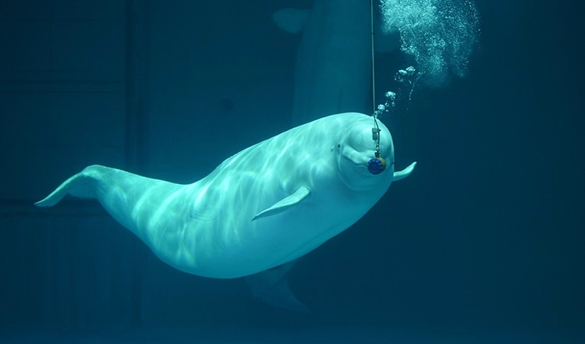
THANK YOU

